Slide 1
粗、细粒度表观模型推断用于视觉跟踪 Inference by Combining Fine-grained and Coarse- grained Appearance Models in Visual Tracking
Xiao Ma
http://turingki.com

Slide 2
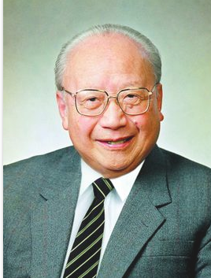
“做一番事业，用的工具要恰到好处，目的是解决问题。 就像屠夫杀猪要用好刀，但这把刀刚好就行，不要整天磨刀，欣赏刀。”
钱伟长 院士

Slide 3
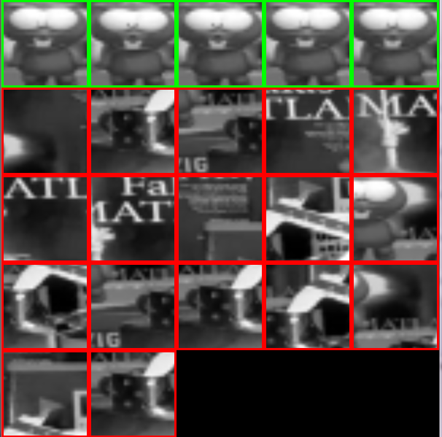
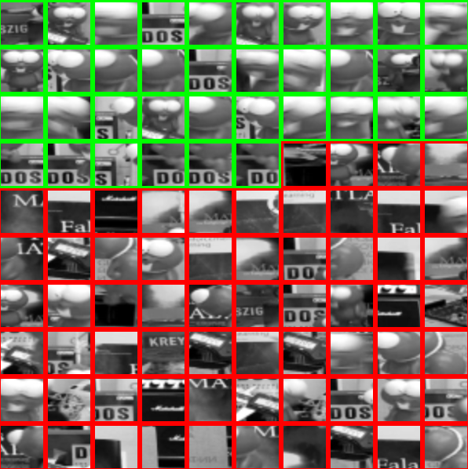
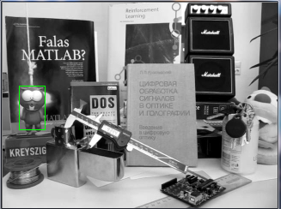
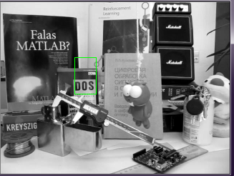
Overfitting for background noises!
Frame #5
Frame #1336

Slide 4
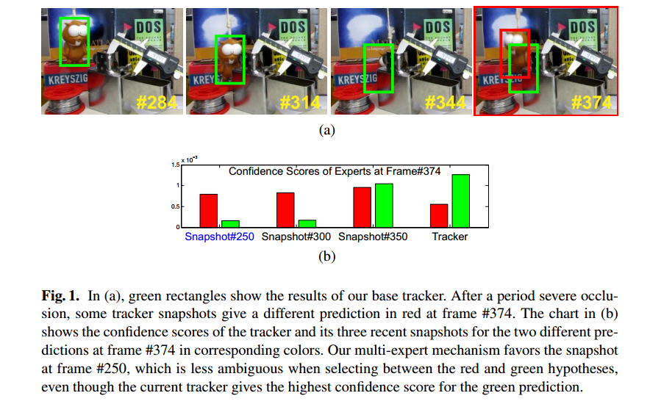
Zhang, J., Ma, S., & Sclaroff, S. (2014). MEEM: Robust tracking via multiple experts using entropy minimization. In Computer Vision–ECCV 2014 (pp. 188-203). Springer International Publishing.
http://turingki.com/research/img/meem.pdf

Slide 5
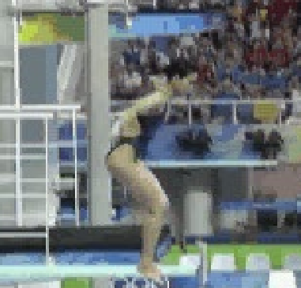
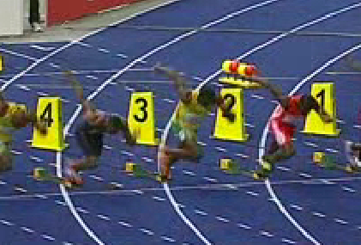
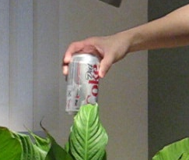
Bolt -OCC DEF IPR OPR -100
Diving -SV DEF IPR
Single features space model is hard!
Coke -IV OCC FM IPR OPR BC

Slide 6
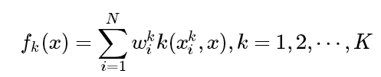
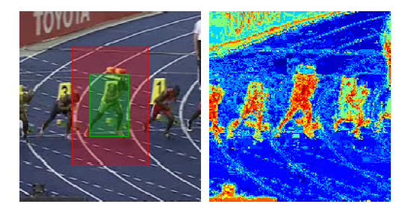
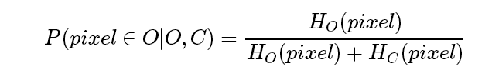
We break the single LaRank process to multiple appearance models according to the differences of positive samples.
We call those linear combinations are Fine-grained appearances.
Then we introduce a color based model-free(MF) as a Coarse- grained appearances:

Slide 7

The final probability of candidates object is determined by:
All about inference!

